Slide 1

NEXORA HR EMPLOYEE ANALYTICS DASHBOARD
A Power BI Project on the Nexora HR Employee Attrition Dataset
PRESENETED BY
Rudrashis Chowdhury, Gourab Mondal and Tuhin Roy
DATE
2nd August 2026

Slide 2
Project Overview
1
Project Objective
Analyze Nexora HR attrition data to uncover workforce and attrition trends.
TOOLS USED
Power BI
2
Business Problem
High employee attrition impacts cost, productivity, and morale.
Power Query
3
Tools Used
Power BI, Power Query, DAX, and Excel for end-to-end analysis.
DAX
4
Expected Outcomes
An interactive dashboard that enables data-driven HR decisions.
Excel (CSV Dataset)
HR Employee Analytics Dashboard
2

Slide 3
Dataset & Data Cleaning
DATASET
DATA CLEANING
✓
Imported the CSV dataset into Power Query
1,470
35
✓
Removed EmployeeCount, Over18, StandardHours
Total Records
Total Columns
✓
Verified column data types
Source: Nexora HR Employee Attrition dataset
✓
Checked for duplicate records
✓
Checked for missing values
HR Employee Analytics Dashboard
3

Slide 4
DAX Measures & Calculated Columns
DAX MEASURES
CALCULATED COLUMNS
fₓ
Total Employees
C
Age Group
fₓ
Employees Left
C
Salary Band
fₓ
Employees Stayed
C
Company Tenure Group
fₓ
Attrition Rate
fₓ
Average Salary
fₓ
Average Age
HR Employee Analytics Dashboard
4

Slide 5
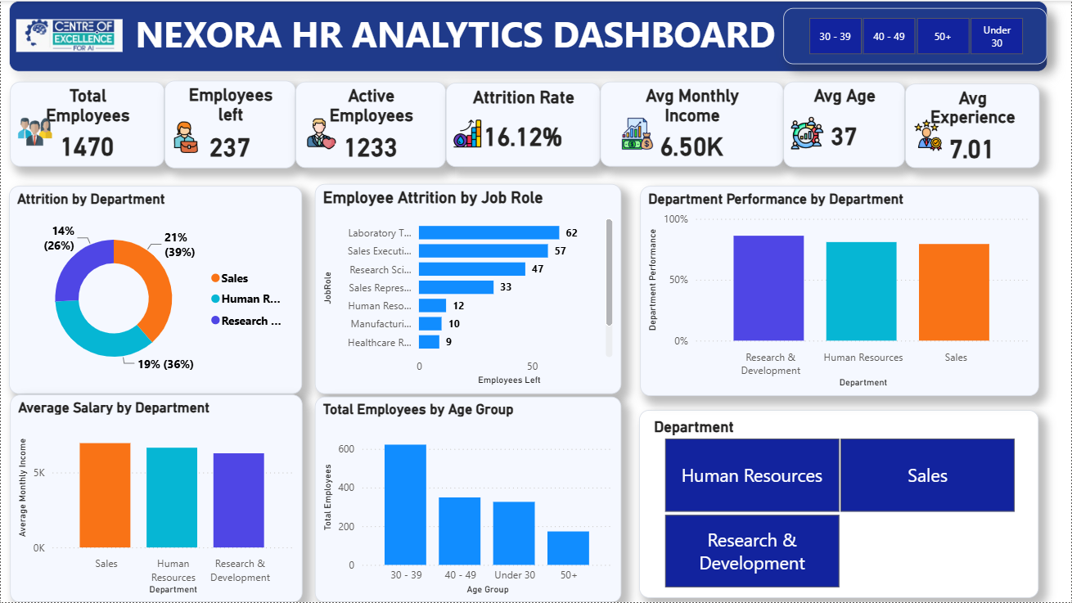
Dashboard Page 1 – Overview
WHAT TO NOTICE
KPI cards: Total Employees, Employees Left, Attrition Rate, Average Salary
Average Salary by Department and by Job Role
Employees Left by Job Role and by Department
Age distribution and Salary Band split
HR Employee Analytics Dashboard
5

Slide 6
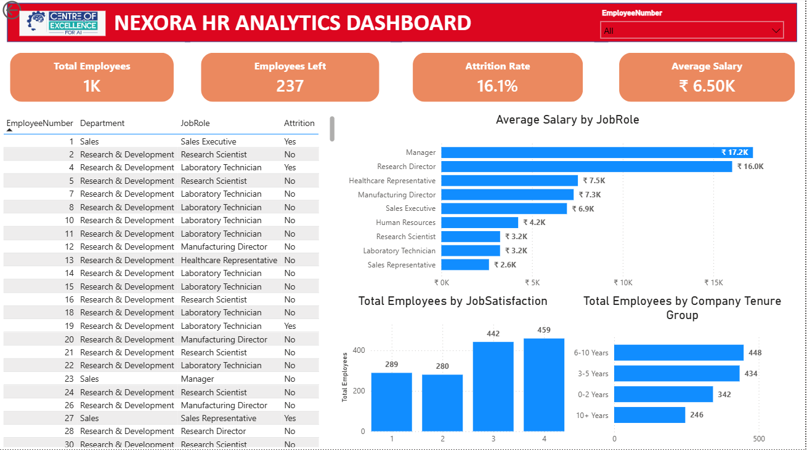
Dashboard Page 2 – Employee Details
WHAT TO NOTICE
Employee Details table with drill-through to individual records
Average Salary by Job Role
Total Employees by Job Satisfaction
Total Employees by Company Tenure Group
HR Employee Analytics Dashboard
6

Slide 7
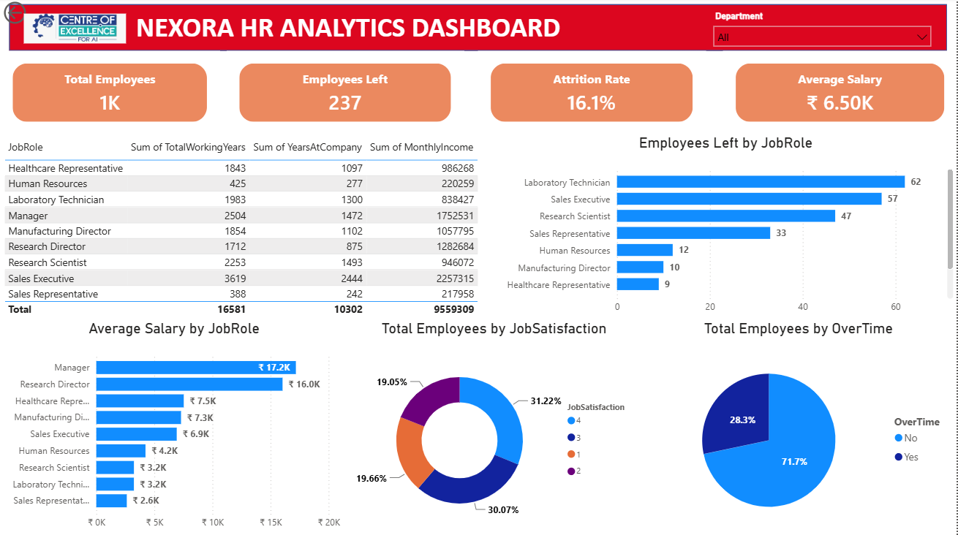
Dashboard Page 3 – Department Performance
WHAT TO NOTICE
Department summary table (working years, tenure, income)
Employees Left by Job Role and Average Salary by Job Role
Job Satisfaction breakdown
Overtime analysis
HR Employee Analytics Dashboard
7

Slide 8
Key Insights
1,470
237
16.1%
Total Employees
Employees Left
Attrition Rate
WHAT THE DATA SHOWS
→
Research & Development has the highest attrition among departments.
→
Managers have the highest average salary of all job roles.
→
Employees working overtime show a higher likelihood of attrition.
HR Employee Analytics Dashboard
8

Slide 9
Business Recommendations
1
Improve employee engagement
2
Review overtime policies
3
Increase career development opportunities
4
Enhance employee retention programs
5
Conduct regular employee satisfaction surveys
HR Employee Analytics Dashboard
9

Slide 10
Conclusion
Built an interactive HR Analytics Dashboard using Power BI
Performed data cleaning using Power Query
THANK YOU
Created DAX measures and calculated columns
Questions & Answers
Implemented KPIs and drill-through pages
Enabled data-driven HR decision-making
Rudrashis Chowdhury • MCA
Amity University, Noida
HR Employee Analytics Dashboard
10

